Slide 1

Contact Information
www.innovationcenteroftherockies.com
LinkedIn Page: https://www.linkedin.com/company/innovation-center-of-the-rockies
Tim Bour
Executive Director
Innovation Center of the Rockies
1155 Canyon Blvd, Suite 400
Boulder, CO 80302
tim@innovationcenteroftherockies.com
303-444-2111
Notes:
1

Slide 2
What problem did we solve
Tracking projects across 5 universities, trying to boost commercialization, economic impact of research coming from university faculty. Tracking established companies, mainly startups, in the Boulder/Denver metro area, Wyoming and recently Launch NY (an Upstate NY economic development organization). We have touched ~1000 projects since 2006.
Wanted a tool that could scale with the ICR as we expanded the universities and economic development organizations we work with. Decided on software that was cloud based, commercial grade, clear lines of ownership for compatibility to MS Outlook.
Project Tracking Definition: Real time reporting of all university commercialization projects across 5 universities. Report by technology segment, by individual faculty, capture advisor email history, published articles, PPT presentations, critical process milestones, commercial outcome. Similar real time tracking of the established companies we work with. Customized templates based on the goals of the ED organization. Focused on overcoming key challenges faced by company.
Notes:
2

Slide 3
How do we use it today
1) Project tracking for ~300 university projects and ~700 established companies. Things tracked by individual project (university):
ICR staff meetings with faculty. Emails, papers, PPT, meeting notes
Key milestone dates from first faculty contact through startup
Email history and connections to domain expert advisors
PPT presentations, publications, meeting notes
2) CRM database that holds 4500+ individuals.
This includes 1700 domain expert advisors that we match to university projects and established companies we are working with. (Can sort by technology segment, business expertise, interest in being a founder of a startup)
Notes:
3

Slide 4
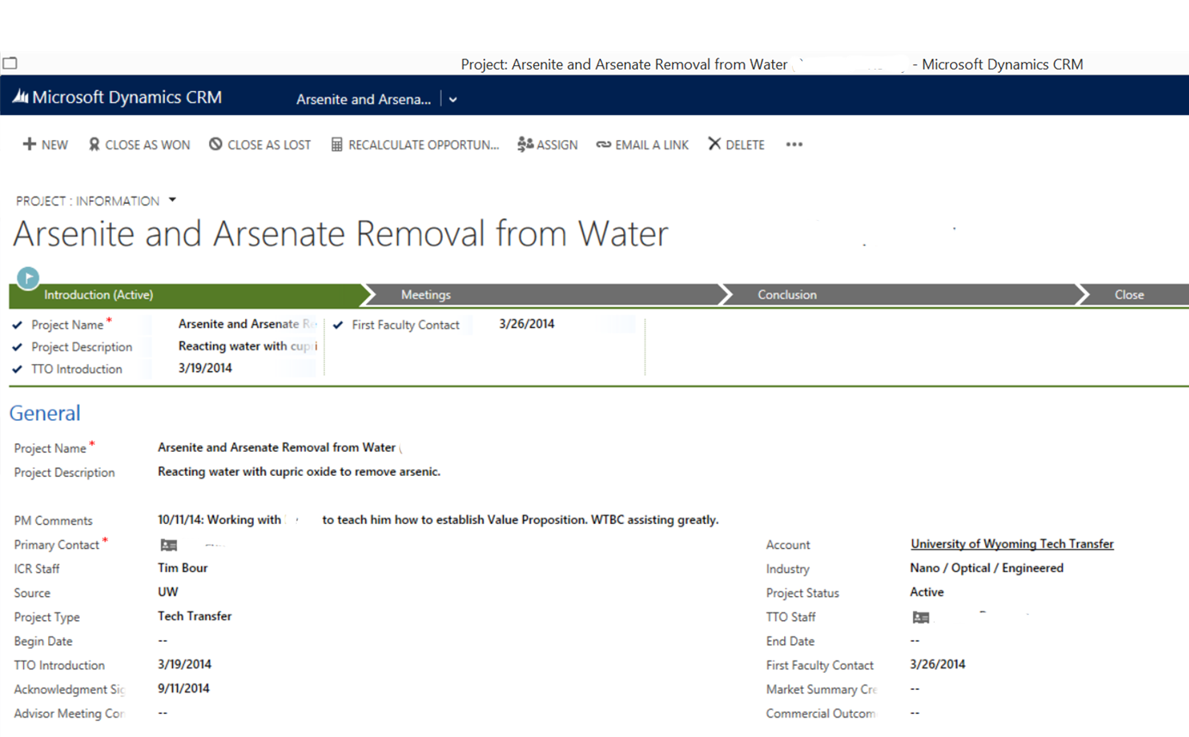
How do we use it today (University Example)
Notes:
4

Slide 5
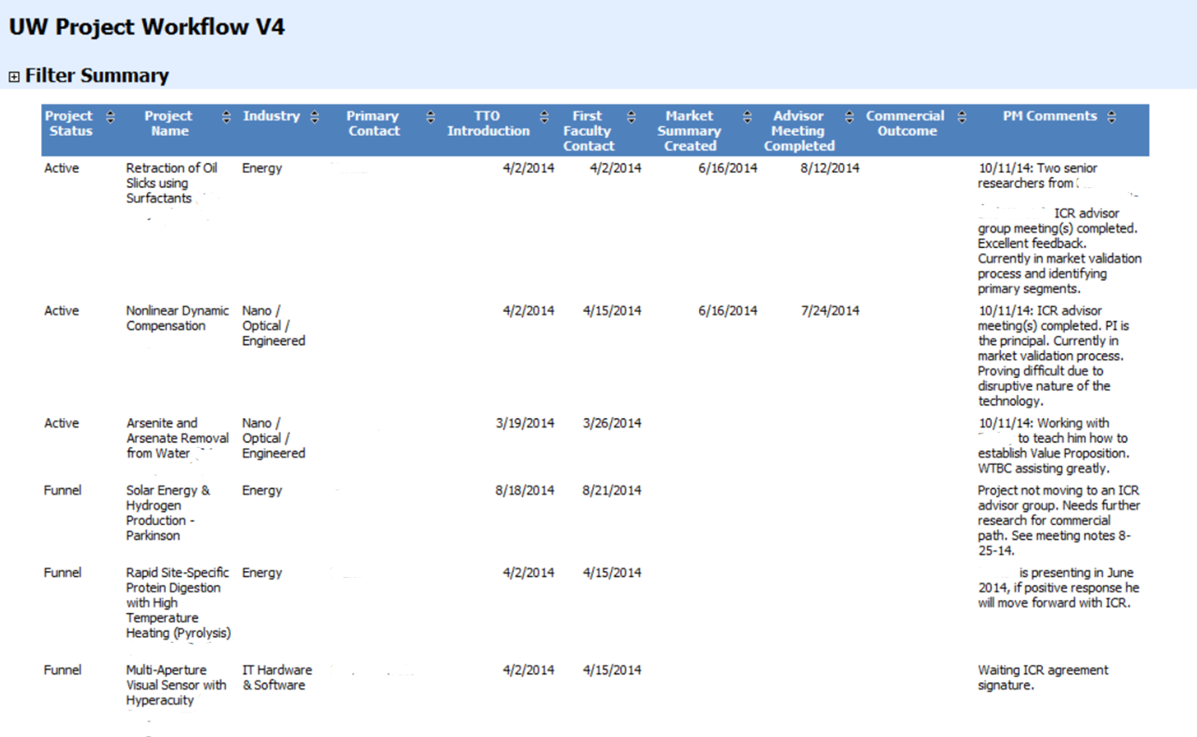
How do we use it today (University Example)
Notes:
5

Slide 6
Lessons we have learned
We are automating capture of relevant data as much as possible and supplement with back office staff. Hard to train ICR Program Manager’s on CRM who are not full time.
Tracking business processes is a key value add within CRM.
Processes need to be well defined, assign someone within the organization to map process into the CRM system.
We recommend the minimum amount of customization initially and review annually what processes should be integrated into CRM:
Identify business processes that are stable, widely used for CRM
Use an external VAR (value added reseller) for custom work, manipulation of the SQL database
Notes:
6

